Slide 1
Workman
Group Members :
Name : Zahid Sher Khan
RegNo : 19MDSWE054
Name : Afaq Ahmad
RegNo : 19MDSWE071

Slide 2
Introduction
We are developing an app
Which will provide services to Labors
Which will provide Labor services to those in needs.
Which will connect labors to the customers

Slide 3
Research
Apps available on playstore on our idea
DayLabor
AsanJobs
Kardaan
Drawbacks of these apps :
The first app is only showing jobs listed by organizations , their interface is confusing
The second app is not providing services , it is nearly dead
The third app is providing limited services in only three cities
All of these app are not hiring any Labors they are providing their own labors
Why our app
Our app scope is district level and there is no such app which are providing these services in our district
We will be providing more services than these apps
Our app will connect labors to the people while these apps are only providing labors not hiring.

Slide 4
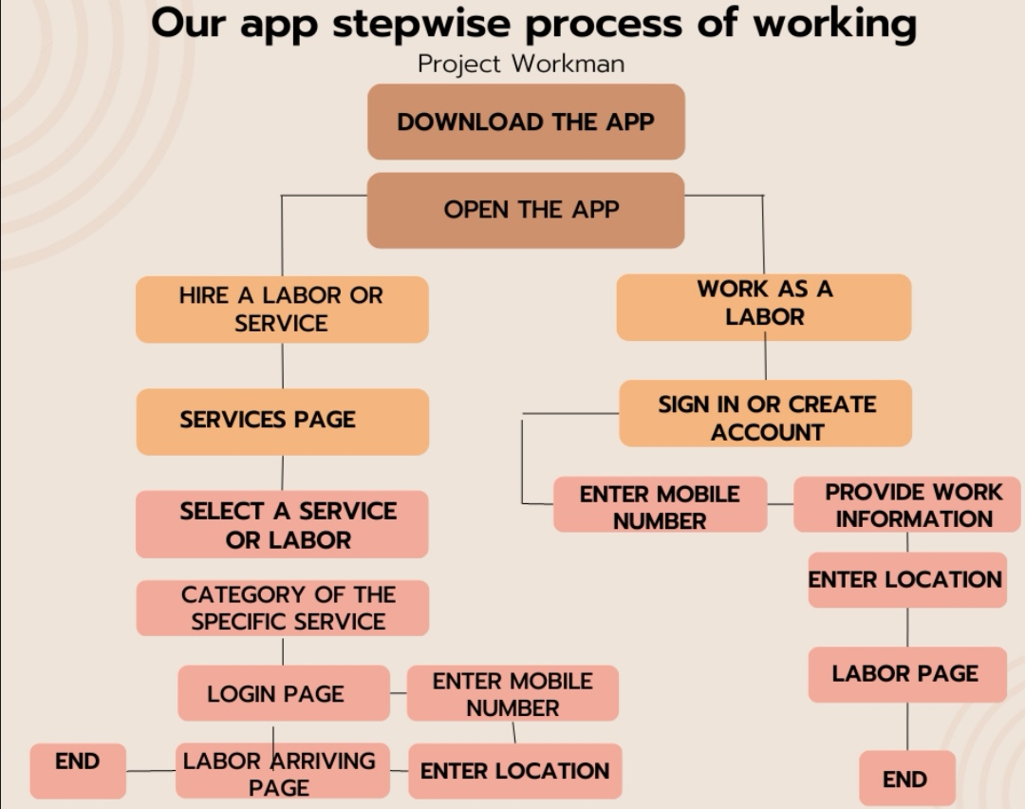
Our App working process

Slide 5
Features
Hire a labor of according to your demands
Hire a service you need
Connect with our app as a labor

Slide 6
Objectives
To overcome poverty and Unemployment by providing jobs to Labors.
To make life easy for people to get labor services by just click of a button.
To provide affordable services and reasonable prices.
To provide different services at one place at your doorstep.

Slide 7
Tools and technology
App frontend
React Native
Backend Technology
Node js
Emulators
Android studio
Coding environment
Visual studio code
UI/UX
Figma
Version control
GitHub

Slide 8


